Slide 1
Kotlin for Spring Boot: A Modern Approach to Java Development
Mohamedsaif Sarfarazbhai Patel Student ID: 991707522 Class: 1251_93666 Instructor: Mallika Mallika Option 2: Teach Us Something

Slide 2
Introduction
A statically typed programming language by JetBrains.
Fully interoperable with Java.
Provides null safety, concise syntax, and modern programming features.
Used for backend, Android, and cross-platform development.

Slide 3
What is Kotlin?
A statically typed programming language by JetBrains.
Fully interoperable with Java.
Provides null safety, concise syntax, and modern programming features.
Used for backend, Android, and cross-platform development.

Slide 4
What is Spring Boot?
Framework for creating stand-alone, production-grade Spring applications.
Reduces boilerplate configuration.
Built-in embedded server (Tomcat).
Supports RESTful APIs and Microservices architecture.

Slide 5
Why Kotlin for Spring Boot?
Null safety helps avoid NullPointerExceptions.
Data classes reduce boilerplate code.
Extension functions increase modularity.
Coroutines support asynchronous programming.
Improves code readability and maintainability.

Slide 6
Project Overview: Student Management App
Technologies used:
Kotlin
Spring Boot
Thymeleaf (UI)
H2 Database
Functionalities:
Add, View, Update, Delete Students
REST API with Kotlin and Spring Boot
Simple and clean UI using Thymeleaf

Slide 7
Feature Walkthrough
Add Student: Form to input name, age, email, course.
View Students: Display list of all students.
Get by ID: Fetch student by unique ID.
Update Student: Edit existing student details.
Delete Student: Remove student from the system.

Slide 8
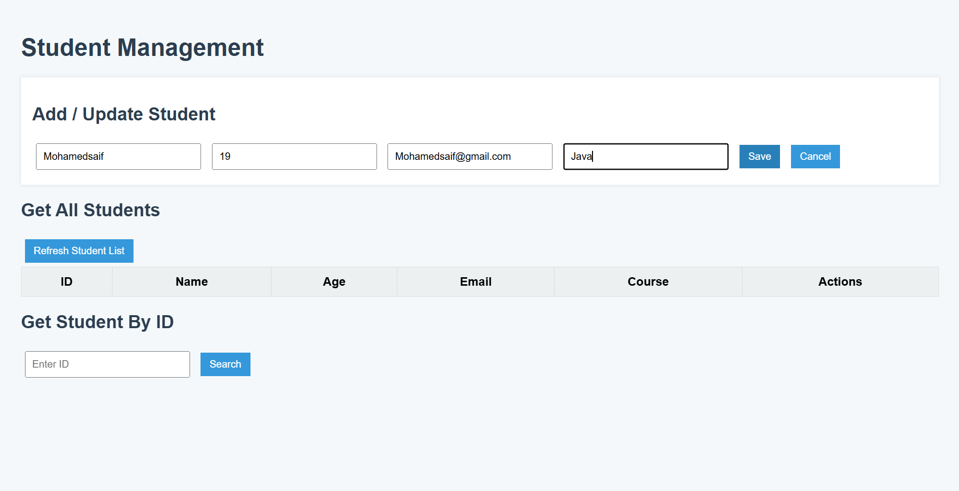
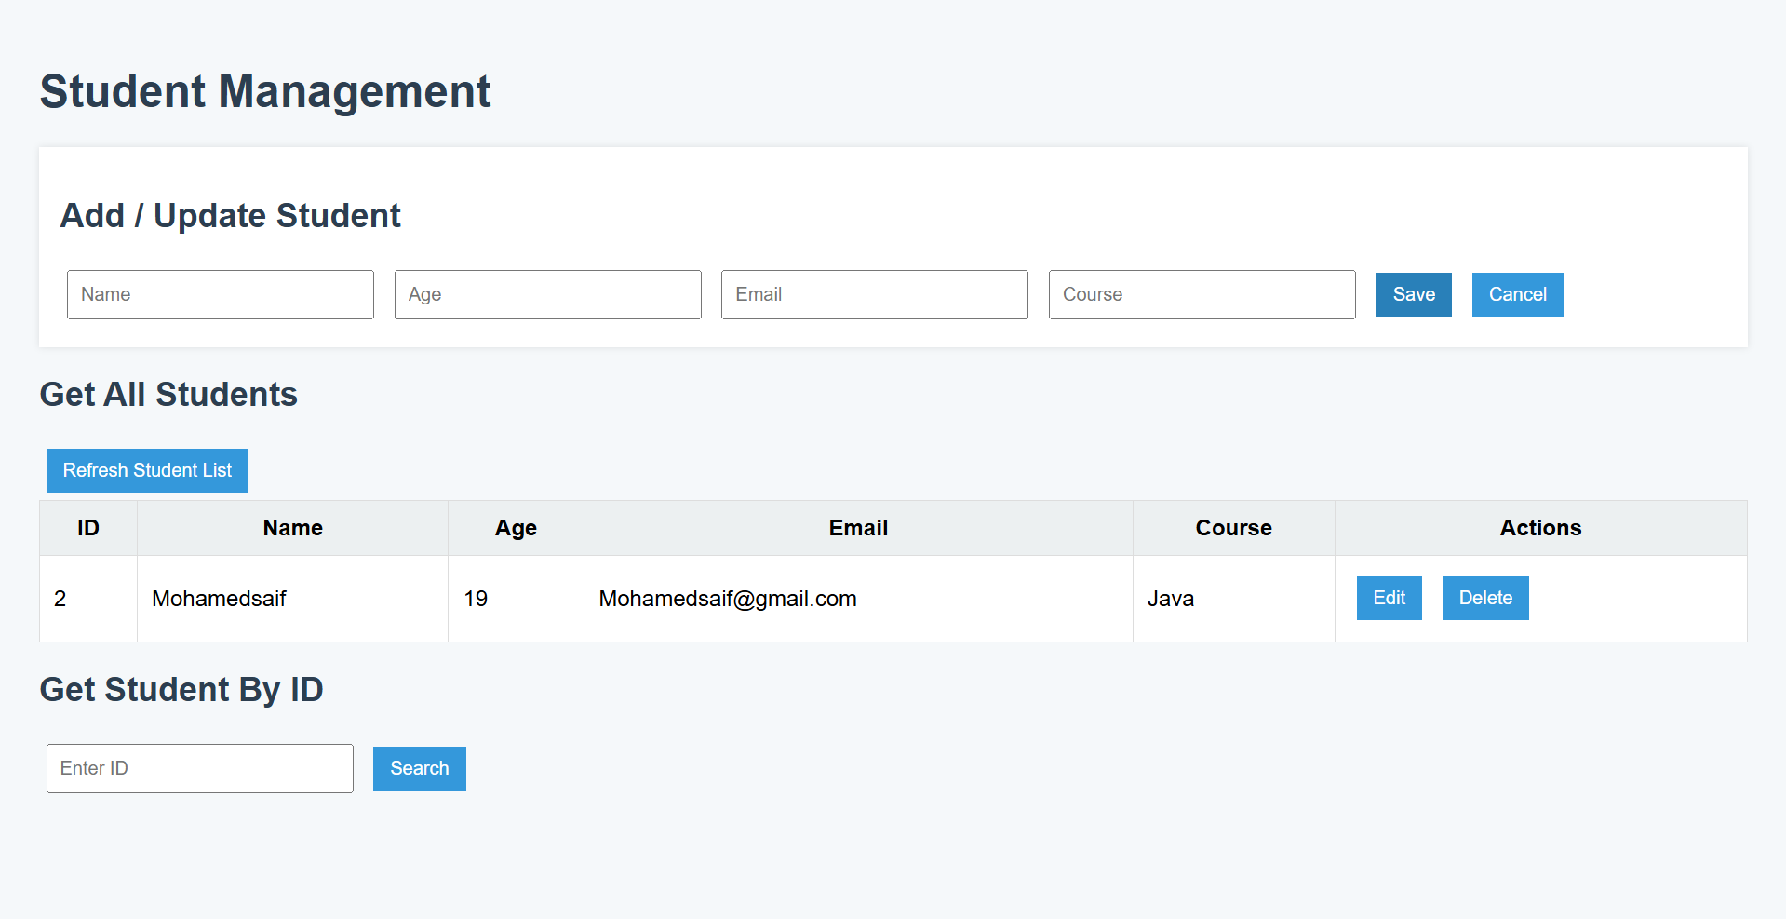
Live Demo (Screenshots)
Adding a student

Slide 9
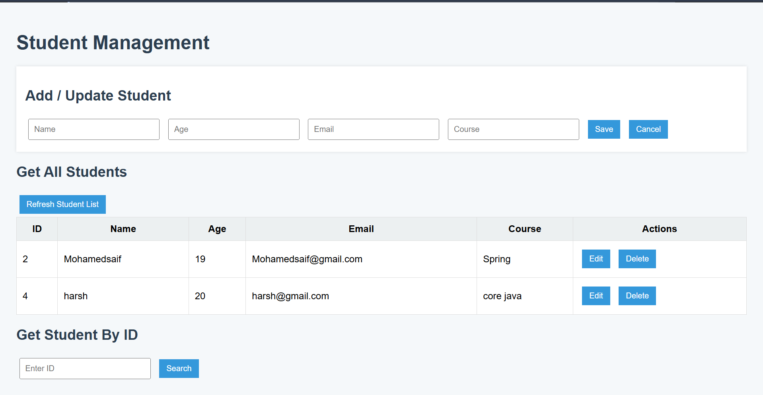
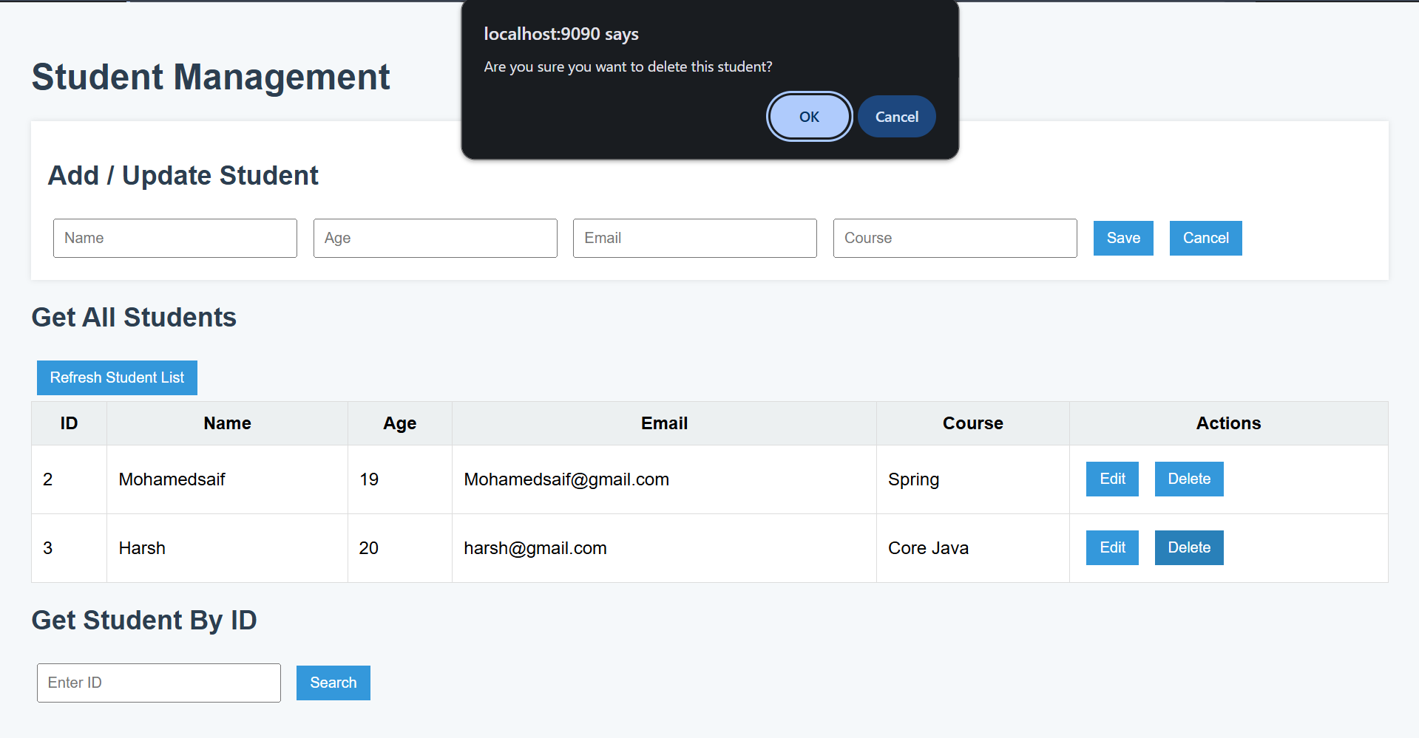
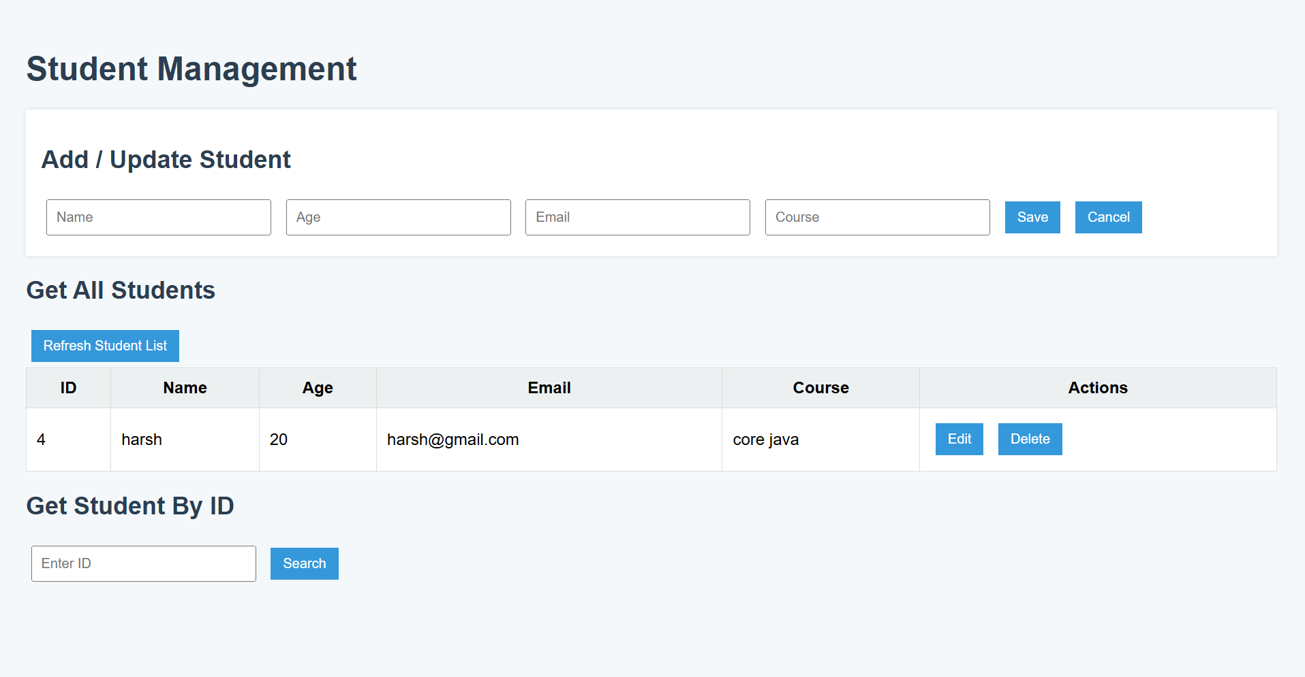
Live Demo (Screenshots)
Editing and deleting

Slide 10
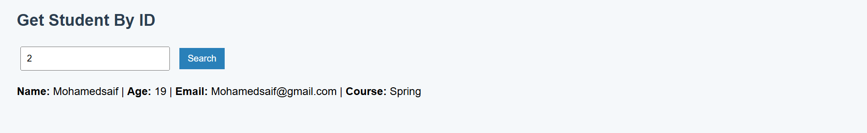
Live Demo (Screenshots)
Get Student By ID

Slide 11
Java vs Kotlin: Code Clarity, Efficiency & Maintainability
Aspect | Java | Kotlin
Code Clarity | Verbose syntax, lots of boilerplate (getters/setters) | Concise syntax, data class, type inference
Efficiency | Manual null checks, more setup needed | Built-in null safety, faster development with fewer lines
Maintainability | More code = harder to read, test, and refactor | Less code = easier to maintain, test, and upgrade

Slide 12
Why Should We Care?
Kotlin is becoming the preferred language for backend and Android.
Big companies (Google, Netflix) use Kotlin.
Improves productivity and code quality.
Great skill for your resume and future projects.

Slide 13
Conclusion & Q&A
Kotlin + Spring Boot = Modern, efficient backend development.
Student Management App shows practical usage.
Encouragement to explore Kotlin.
Any questions?

